Slide 1
CPC case Department: Respiratory Medicine 10th June 2016
Presenter: Dr Aditi Bansal, Resident, Chest & TB
Primary discussant: Dr Sheetu Singh, Assistant Prof , Chest & TB
Radiology discussant: Dr Pragya Chaturvedi, Resident, Radiology
Dr CP Swarnakar, Prof, Radiology
Pathology discussant: Dr Ruchi Agarwal, Sr Demonstrator Pathology
Dr Dilip Ramrakhiani, Assoc Prof, Pathology
Microbiology discussant: Dr Shivra Batra, Sr Demonstrator Microbiology
Dr Aruna Vyas, Professor, Microbiology

Slide 2
Presenting complaints
A 22y male presents with
Dyspnoea on exertion
Productive cough
Fever
4 year
2 months

Slide 3
History of presenting illness
Asymptomatic till 4 year back when he developed dyspnoea on exertion.
Insidious onset
Progressive (from MMRC grade I → grade IV)
No postural or diurnal or seasonal variation
No aggravating or relieving factors
Notes:
MRC Dyspnoea ScaleGradeDegree of breathlessness related to activity
1Not troubled by breathless except on strenuous exercise
2Short of breath when hurrying on a level or when walking up a slight hill
3Walks slower than most people on the level, stops after a mile or so, or stops after 15 minutes walking at own pace
4Stops for breath after walking 100 yards, or after a few minutes on level ground
5Too breathless to leave the house, or breathless when dressing

Slide 4
History of presenting illness
Cough
Insidious in onset
Gradual progressive
Associated with 5-10ml of mucoid expectoration
No postural, diurnal or seasonal variation

Slide 5
History of presenting illness
Fever was present on and off since 2 months.
Low grade
Intermittent type
No diurnal variation
Relieved by medications

Slide 6
History of presenting illness
No history of
Hemoptysis
Chest pain
Allergic rhinitis, Urticaria
Joint pains, photosensitivity
Rashes
Drug intake, Jaundice
Palpitation
Blood transfusion
Trauma

Slide 7
Past medical history
Patient was taking anti-tubercular treatment* since past 2 months and had no relief in symptoms from same.
No H/O of DM or other medical condition
Notes:
*(Isoniazid, Rifampicin, Pyrazinamide and Ethambutol)

Slide 8
Personal history
Non smoker
Non alcoholic
Unmarried
Student
Wrestling was his hobby
Normal sleep, appetite, bowel and bladder habits

Slide 9
Family history
Brother died of tuberculosis 2 years back

Slide 10
Examination findings
General physical examination
Patient was conscious, cooperative and well oriented to time, place and person.
Pallor Absent
Icterus Absent
Clubbing Absent
Cyanosis Absent
Lymphadenopathy Absent
Edema Absent
Neck veins Normal

Slide 11
Examination findings
Vitals
Pulse = 100/min (regular, normal volume and character, with no vessel wall thickening, no RR or RF delay, all peripheral pulses felt )
Respiratory rate = 35/min abdomino-thoracic
Blood pressure = 110/70 mm of Hg right arm supine position
Febrile to touch
SpO2 = 90% on room air

Slide 12
Respiratory system examination
Inspection
Chest symmetrical & bilateral equal chest movements
Trachea central
No scars, sinuses and dilated veins
Accessory muscles of respiration active

Slide 13
Examination findings
Palpation
Inspectory findings are confirmed
Percussion
Bilateral equal resonant note
Auscultation
Bilateral equal vesicular breath sounds.
Fine end-inspiratory crepitations present in bilateral infra-scapular areas

Slide 14
Other system examination
CVS: S1 and S2 normal , No murmur.
CNS : WNL
GIT: No organomegaly, bowel sound present.

Slide 15
Investigations
Cell count
Hemoglobin -15g/dl
WBC – 13000/µl (N:86.8%,L:7.9%, M:5%, E:0.1%)
Platelets – 3.22 lac/µl
Hct – 45.9%
MCV – 92.7 fl
MCH – 30.2 pg
MCHC – 32.6 g/dl
ESR – 80 mm in 1st hour
PBF :
RBC : normocytic and normochromic , no parasites seen.
WBC : adequate , no immature cell seen .
Platelets: adequate

Slide 16
Investigations
Biochemistry
BSR – 90 mg/dl
S. Urea – 31 mg/dl
S. Creatinine – 0.8mg/dl
S. Bilirubin : 0.6/ 0.2/ 0.4
SGOT : 26 IU/L
SGPT : 34 IU/L
S. Protein - 5.8 g/dl
S. Albumin - 3.6 g/dl
S. Globulin - 2.2 g/dl
Serum LDH – 624 U/L
HIV – Non reactive
Malarial parasite – non reactive
Notes:
An elevated level of LD may be seen with:
Hemolytic anemia
Pernicious anemia (megaloblastic anemia)
Infections such as infectious mononucleosis (mono), meningitis, encephalitis, HIV
Sepsis
Intestinal and lung (pulmonary) infarction
Acute kidney disease
Acute liver disease
Acute muscle injury
Pancreatitis
Bone fractures
Testicular cancer, lymphoma or other cancers

Slide 17
Investigations
Sputum examination
AFB – Negative
Gram stain & Pyogenic C/S – No organism isolated
KOH mount & Fungal culture – No organism isolated
ECG – Normal
Mantoux test – Positive (10×12mm)

Slide 18
Investigations
Arterial blood gas analysis (ABG)
pH- 7.39
pO2- 56 mm Hg
pCO2- 41 mm Hg
HCO3- 25 mm Hg
SpO2- 90%
A-a – 44.6 mm Hg
Type I respiratory failure

Slide 19
Summary
A 22 year old male student presented with shortness of breath (4yrs), cough (4yrs) and intermittent fever (2months)
On examination: Respiratory distress, end-inspiratory crepts present B/L
CBC revealed ↑ counts & Serum biochemistry revealed ↑ LDH
Positive Mantoux test

Slide 20
??
Notes:
Pleural
Bronchial
Parenchymal
Interstitial
Vascular
Infective
Non-infective

Slide 21
Differential diagnosis
Bronchial
Interstitial
Alveolar
Pleural
Vascular
Infective
Non-infective

Slide 22
Chest X ray (10/2/2016)

Slide 23
FEV1 = 1.18L (63%)
FVC = 1.26L (57%)
FEV1/FVC = 88%

Slide 24
TLCO = 75%

Slide 25
Differential diagnosis

Slide 26
Bronchial
Interstitial
Alveolar
Pleural
Vascular
Infective
Non-infective

Slide 27
Differential diagnosis
1 | Infective
2 | Non infective-
 | Interstitial lung disease (ILD)
 | Vascular: Chronic pulmonary thromboembolism

Slide 28
Differential diagnosis
Pneumonia
Bacterial
Points in favor: Counts raised
Points against: Chronic disease, intermittent fever
Fungal
Points in favor: Chronic illness, fever, productive cough
Points against: Sputum KOH & Fungal culture negative

Slide 29
Differential diagnosis
Tubercular
Points in favor: Chronic illness, fever, family history of tuberculosis, Positive Mantoux test, Raised ESR
Points against: No response to ATT, sputum AFB smear negative, CXR shows basal predominant disease

Slide 30
Differential diagnosis
ILD
Points in favor
Chronic illness, cough, dyspnoea, diffusion defect
Points against
Age against ILD, no history of connective tissue disease, no exposure history (including occupational)

Slide 31
Differential diagnosis
Chronic PTE
Points in favor
Chronic illness, dyspnoea, diffusion defect, raised LDH
Points against
No predisposing conditions

Slide 32
Next investigation?
Notes:
Bronchoscopy

Slide 38
Radiological discussion
Dr.PRAGYA CHATURVEDI ( Junior Resident)
Guided by– Dr. C.P SWARNAKAR
Professor
DEPARTMENT OF RADIODIAGNOSIS AND MODERN IMAGING

Slide 39
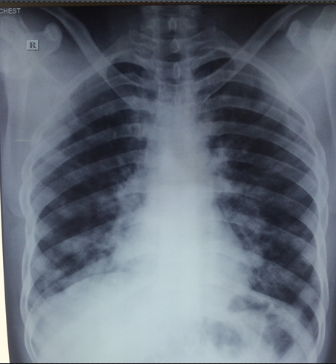
PA chest radiograph showing patchy bilateral air space opacity predominantly in lower zones.

Slide 40
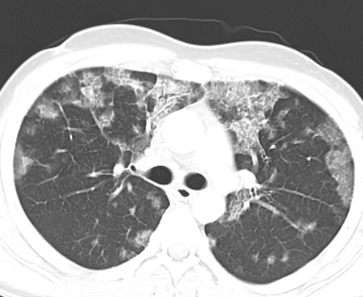
AXIAL HRCT OF THE LUNGS SHOWING GROUND-GLASS OPACITIES WITH SEPTAL THICKENING(CRAZY PAVING)

Slide 41
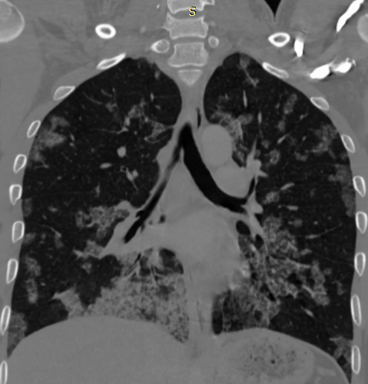
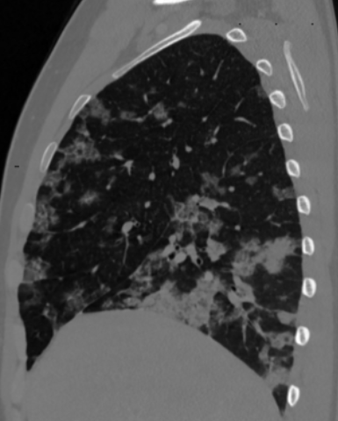
CORONAL & SAGITTAL CT OF THE LUNGS SHOWING BILATERAL CRAZY-PAVING.

Slide 42
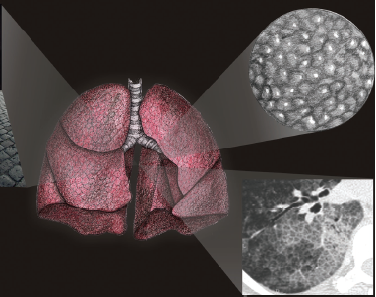
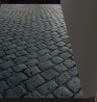
Photograph of a colonial-era pavement street in Buenos Aires, Argentina (left), drawings of the lungs (center) and lung tissue (top right), and close-up high-resolution CT scan (bottom right) show the crazy-paving pattern.

Slide 43
Differential diagnosis of crazy paving pattern
Sanguinous
ARDS
Pulmonary hemorrhage
Infection
Pneumocystis Jirovecii
Inhalation
Lipoid pneumonia
Neoplasm
Bronchoalveolar carcinoma
Idiopathic
Pulmonary alveolar proteinosis
Non specific pneumonia
Cryptogenic organizing pneumonia

Slide 44
ARDS
POINTS AGAINST
Chronic history
Dense consolidation in dependent regions of lung
Absence of pulmonary cysts of varying sizes and bullae
POINTS IN FAVOUR
GGO with interlobular and intralobular septal thickening

Slide 45
ACUTE INTERSTITIAL PNEUMONIA
OR HAMMAN RICH SYNDROME
POINTS IN FAVOUR
POINTS AGAINST
GGO with interlobular and intralobular septal thickening
Chronic history
Absence of air space consolidation have a slight predilection towards the dependent portions
Absence of traction bronchiectasis (can be seen in ~80% of cases and correlates with disease duration)
Absence of lung parenchymal architectural distortion

Slide 46
PULMONARY HAEMORRHAGE SYNDROMES
POINTS IN FAVOUR
POINTS AGAINST
Absence of hemoptysis, and anemia
GGO with interlobular and intralobular septal thickening
Absence of acute onset of symptoms

Slide 47
Differential diagnosis of crazy paving pattern
Sanguinous
ARDS
AIP
Pulmonary hemorrhage
Infection
Pneumocystis Jiroveci
Inhalation
Lipoid pneumonia
Neoplasm
Bronchoalveolar carcinoma
Idiopathic
Pulmonary alveolar proteinosis
Non specific interstitial pneumonia
Cryptogenic organizing pneumonia

Slide 48
How to proceed further?

Slide 49
Differential diagnosis
Sanguinous
ARDS
AIP
Pulmonary hemorrhage
Infection
Pneumocystis Jirovecii
Inhalation
Lipoid pneumonia
Neoplasm
Bronchoalveolar carcinoma
Idiopathic
Pulmonary alveolar proteinosis
Non specific interstitial pneumonia
COP

Slide 50
Any other investigations needed?

Slide 51
How to proceed further?

Slide 52
Bronchoscopy
Bronchoalveolar lavage (BAL)
Transbronchial lung biopsy (TBLB)

Slide 53
Pathological Discussion
Dr Ruchi Agrawal
Senior Demonstrator
Under guidance
Dr Dilip Ramrakhiani
Associate Professor
Department of Pathology

Slide 54
Bronchoalveolar Lavage fluid

Slide 55
BAL sample from the patient showing abundant granular & globular material with relative paucity of macrophages. (H&E stain 400X)

Slide 56
Specimen from same patient with amorphous material showing strong PAS positivity.
(PAS stain 400X)

Slide 57
DIFFERENTIAL DIAGNOSIS
Amyloidosis
Amyloid – Waxy, smooth, non granular, focally deposited & rarely seen in BAL.
Scalloped edges of amorphous eosinophilic masses.
Congo red staining of masses show green birefringence under polarized light

Slide 58
Differentials continued……..
2) Organizing pneumonia
Granular debris in background but inflammatory cells (including neutrophils) usually predominate.
3) Pneumocystis Jirovecii.
4) Pulmonary alveolar proteinosis.

Slide 59
Summary
Gross Appearance of fluid.
Clinical & radiological findings.
Presence of abundant PAS positive extracellular material.

Slide 60
TBLB demonstrate pink granular material filling the air spaces (H&E stain 100X)

Slide 61
TBLB shows embedded clumps of dense eosinophilic globular material & cholesterol clefts (H&E stain 200X)

Slide 62
TBLB-PAS stain is positive & highlights the granular nature of the intra alveolar accumulation (PAS stain 200X)

Slide 63
Differential diagnosis
Pulmonary edema.
Pneumocystis Jirovecii pneumonia.
Pulmonary Alveolar Proteinosis.

Slide 64
Differentials continued…………
Pulmonary edema
Pale pink homogeous fluid in air spaces.
Congestion.
Leakage of some RBC’s into air spaces.
Haemosiderin laden macrophages & alveolar septal thickening & fibrosis in long standing cases.

Slide 65
Differentials continued…………
2) Pnemocystis Jirovecii.
Exudates are finely vacuolated & foamy.
Significantly more inflammatory changes in background lung.

Slide 66
Presumptive Diagnosis: Pulmonary alveolar proteinosis.
Pneumocystis Jirovecii Pneumonia to be excluded.

Slide 67
Diagnosis??

Slide 68
Pulmonary alveolar proteinosis
1. Clinical H/O – Fever
2. HRCT – crazy paving pattern
3. BAL & TBLB – PAS positive material
PJP staining
Pneumocystis Jirovecii
1. Clinical H/O – Fever
2. HRCT – crazy paving pattern
3. BAL & TBLB – PAS positive material

Slide 69
Microbiology discussion
DR SHIVRA BATRA
SENIOR DEMONSTRATOR MICROBIOLOGY
UNDER THE GUIDANCE OF
DR ARUNA VYAS
PROFESSOR MICROBIOLOGY

Slide 70
Investigations
Specimen – Broncho-alveolar lavage (BAL)
Gram staining - No microorganism
Pyogenic culture – No microorganism grown
AFB staining - Negative
KOH mount for fungal elements - few septated hyphae
Fungal culture – Aspergillus Niger isolated
GMS stain for Pneumocystis Jirovecii - Negative for PJP
Notes:
ew

Slide 71
Gomori’s methenamine silver stain of BAL of our patient under 40X magnification

Slide 72
Culture of BAL on SDA: isolated Aspergillus Niger

Slide 73
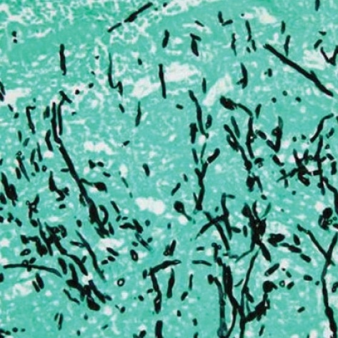
GMS stain for fungal hyphae

Slide 74
Gomori’s methenamine silver stain showing cysts of Pneumocystis Jirovecii in an AIDS patient

Slide 75
Diagnosis
Pulmonary alveolar proteinosis
? Secondary fungal infection with Aspergillus niger
Notes:
BAL was milky, PCP stain was negative, Pt was not immunocompromised

Slide 76
Serum galactomannan <0.5 index

Slide 77
Final Diagnosis
Pulmonary alveolar proteinosis
With Fungal colonization
Notes:
BAL was milky, PCP stain was negative, Pt was not immunocompromised

Slide 78
Pulmonary alveolar proteinosis (PAP)/ Pulmonary alveolar phospholipoproteinosis
A rare lung disorder of unknown etiology characterized by alveolar filling with floccular material that stains positive using the PAS method & derived from surfactant phospholipids and protein components
Notes:
periodic acid-Schiff

Slide 79
Types of PAP
Primary (idiopathic)
Secondary
Hematologic malignancies
Inhalation of mineral dusts such as silica, titanium oxide, aluminum, indium-tin oxide and insecticides
AIDS
Niemann-Pick disease
Myelodysplastic syndrome
Leflunomide - Case report (disease-modifying antirheumatic arthritis therapy)
3. Congenital

Slide 80
PAP: Symptoms
Cough
Dyspnoea
Fatigue and malaise
Weight loss
Intermittent low-grade fever and/or night sweats
Pleuritic chest pain
Cyanosis (rare)
Hemoptysis (rare)

Slide 81
PAP: Complications
Secondary lung infections: Aspergillus, Nocardia, PJP, Mycobacteria
Pulmonary fibrosis
Respiratory failure & cor pulmonale

Slide 82
PAP: Examination findings
Fine end-inspiratory crackles
Clubbing (25%)
Cyanosis (20%)
Pulmonary hypertension and cor pulmonale (rare)

Slide 83
Chest X ray
Reveals bilateral symmetric alveolar opacities located centrally in mid and lower lung zones, often in a "bat wing" distribution.
Notes:
lthough with a typical absence of cardiomegaly or pleural effusion. Unilateral involvement occurs occasionally, and lymphadenopathy is rarely present. Typically, changes progress over weeks to months into a diffuse reticulogranular pattern.

Slide 84
HRCT findings
Crazy paving pattern – ground glass haziness and interlobular septal thickening
Notes:
The crazy-paving pattern also can be observed in exogenous lipoid pneumonia, sarcoidosis, mucinous bronchoalveolar cell carcinoma, and acute respiratory distress syndrome (ARDS).[

Slide 85
Patient with suspected PAP
Clinical manifestations
Elevated LDH
Abnormal chest radiograph
HRCT: typical findings
Fiberoptic bronchoscopy
Bronchoalveolar lavage & TBLB
PAS staining
Negative
Positive
Open or VATS lung biopsy
Diagnosis of PAP

Slide 86
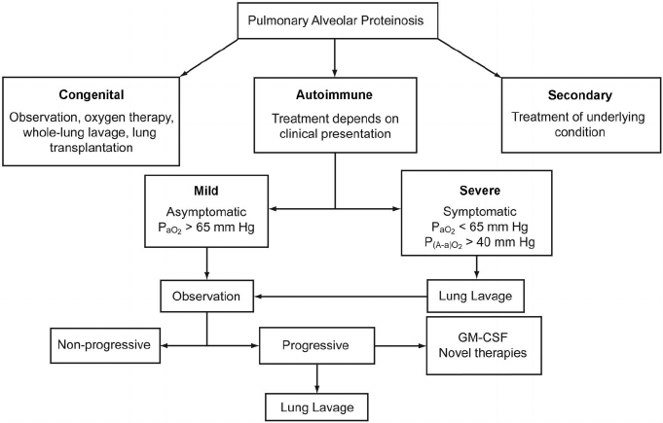
Treatment of PAP

Slide 87
ABG before and after the segmental lung lavage
Before
ph- 7.39
pO2- 56 mm Hg
pCO2- 41 mm Hg
HCO3- 25 mm Hg
SpO2- 90%
A-a – 44.6 mm Hg
After
ph- 7.40
pO2- 66 mm Hg
pCO2- 40 mm Hg
HCO3- 24 mm Hg
SpO2- 93%
A-a – 35.8mm Hg

Slide 88
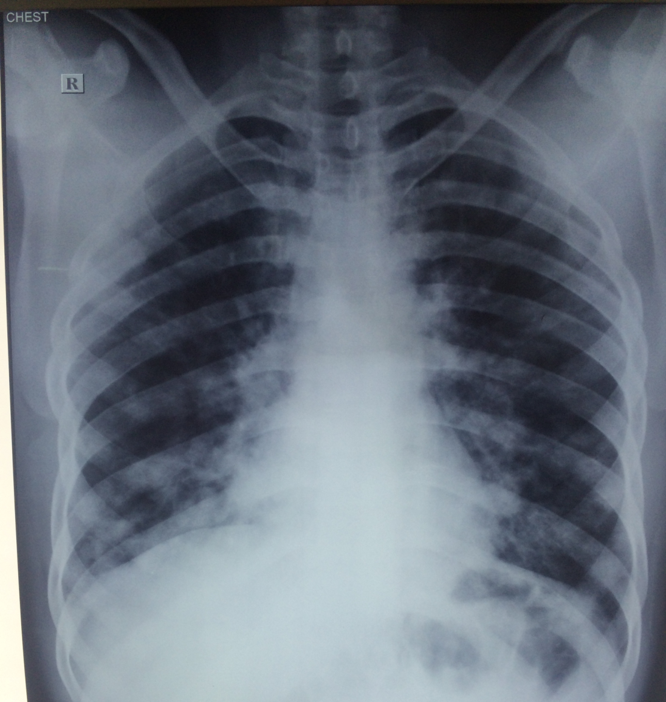
(10/5/2016)
After 3 months
(10/2/2016)

Slide 89
Take home message
Not all pneumonias are tuberculosis
In case of non-responding patient, review the diagnosis
Bronchoscopy is a useful tool to achieve the diagnosis and also for treatment in selected diseases

Slide 90
Thank you for your kind attention & participation!

